Slide 1
How to CoSMO a Simulink Block
Common Simulation Architecture (CSA)
8/11/2010
Mike Sufana & Patrick Healy
Northrop Grumman Corporation

Slide 2
Contents
These charts document the steps required to ensure that each Simulink block component has been brought up to CoSMO (Common Simulation Modeling Objects) standards
Component Overview
Documentation Formatting
CoSMO checklist for Simulink Blocks
Step-by-Step Process for CoSMOing a Simulink Block

Slide 3
Component Overview
What is a “component”?
A component is a validated and documented MATLAB function, Simulink block, C/C++ code, etc. that can be used across all vehicle simulations
Each component will be delivered as a package, in one folder, along with all necessary support files and requisite documentation
Documentation for each component shall address:
Description and Intended Use
What’s the one-line response to ‘what is this component and what does it do?’
Source References and Data
What are the base equations? Where is the source data? What textbook was this cited out of?
Inputs and Outputs
What is the order of inputs and outputs? What are their sizes, dimensions, and units?
Model Dependencies
Does this component rely on another component or file (e.g. function or block)?
Test Procedures and Results
How did you validate this block? What test inputs did you use? Where are plots that compare sample data to the source references?
Establishing a process (or template) for building a CSA component will ensure that…
all necessary support files will accompany component
the basic who, what, where, when, why, and how style questions will be answered
the documentation will have a logical and consistent layout, style, and feel
construction and documentation of components will be easily distributable amongst engineers and departments

Slide 4
Component Documentation (cont)
Documentation should follow a standard convention
MATLAB Scripts / Functions - bold
MATLAB Workspace Variables - Courier New Font
Simulink Subsystem Blocks - Italic
External Documents - Underline
Acronyms shall be clearly defined
Acronym | Description
CM | Configuration Management
CoP | Community of Practice
CoSMO | Common Simulation Modeling Object
CoSMO’d | Act of creating a CoSMO and all associated documentation
CSA | Common Simulation Architecture
GNC | Guidance, Navigation, & Control
I/O | Input / Output
RTCF | Real-Time Component Framework
NGC | Northrop Grumman Corporation

Slide 5
Simulink Block Checklist CoSMO
Create component verification folder
Create component documentation file template
Define acronyms
Define block name, intended use, I/O, Matlab version
Define Simulink block package details
Define underlying math and include reference where appropriate
Include section for verification results (scope screen capture, tables, etc. from component unit test)
Create component Unit Test scripts/files
If existing, include comparisons to Matlab functions that perform same function (especially if existing as a standard Matlab function, not included in CSA)
If existing, include comparisons to components that perform reciprocal functions (i.e. dcm2eul and eul2dcm)
If appropriate, test block for known “easy” cases (i.e. testing Gimbal2PointingDir at 0° pitch and 90° pitch)
If appropriate, check non-intuitive cases with hand calculations (i.e. testing Gimbal2PointingDir at 37.6° pitch and -8.4° yaw)
If appropriate, test for out of range inputs and document behavior
Ensure CSA block has the svn dynamic log fields setup

Slide 6
Contents
These charts document the steps required to ensure that each Simulink block component has been brought up to CoSMO (Common Simulation Modeling Objects) standards
Short List
Approve Ticket once it is assigned to you
Navigate to the CSA’s ‘Verification’ folder
Create a ‘Verification’ folder for the Simulink Block if one does not already exist
Create a ‘Test_<Block Name>.mdl’ in the ‘Verification’ folder (and a ‘DRIVER_<Block Name>.m’ for more complicated blocks that require offline calculations, extensive plotting, etc.)

Slide 7
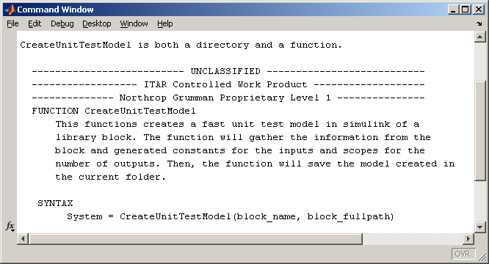
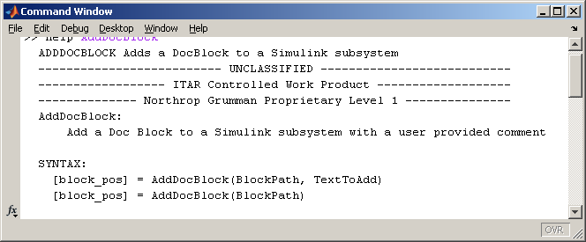
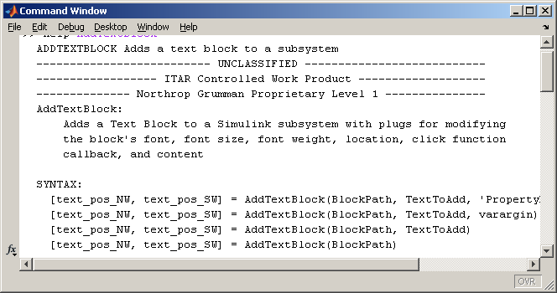
CoSMO Step-by-Step Process for Simulink Blocks
Good Functions to Know
CreateUnitTestModel
AddDocBlock
AddTextBlock
CoSMO(‘b’, …)

Slide 8
CoSMO Step-by-Step Process for Simulink Blocks
Good Functions to Know
Approve Ticket once it is assigned to you
Navigate to the CSA’s ‘Verification’ folder
Create a ‘Verification’ folder for the Simulink Block if one does not already exist
Create a ‘Test_<Block Name>.mdl’ in the ‘Verification’ folder (and a ‘DRIVER_<Block Name>.m’ for more complicated blocks that require offline calculations, extensive plotting, etc.)

Slide 9
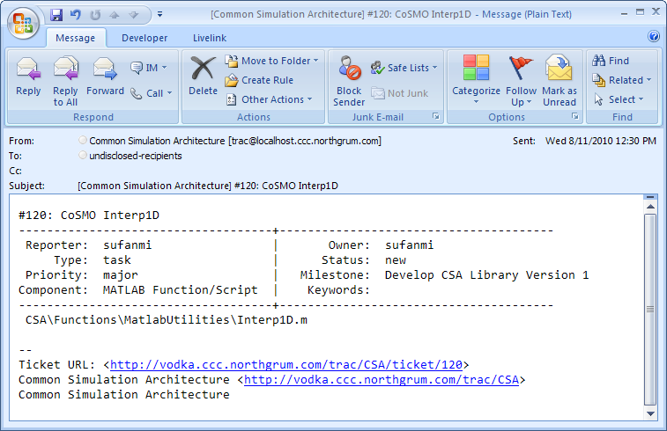
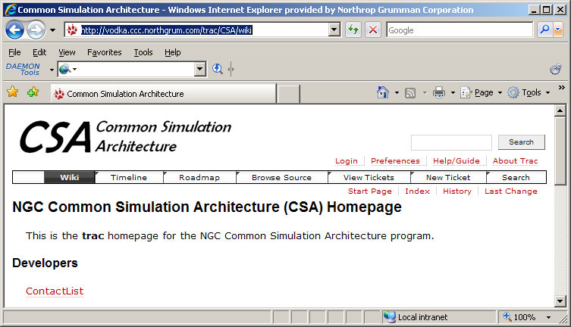
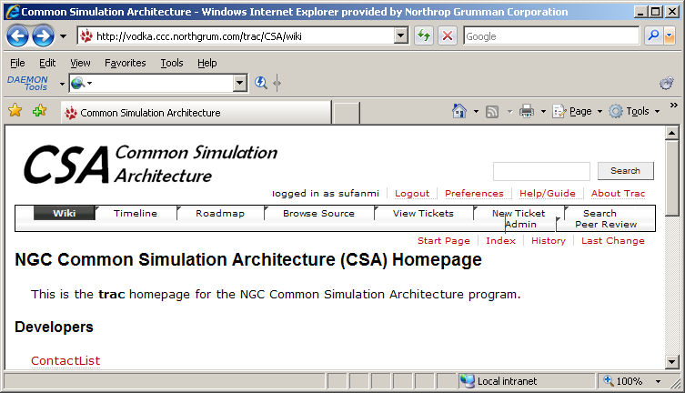
CoSMO Step-by-Step Process for Simulink Blocks
This step-by-step process documents the CoSMOing of the VNorm block
Step 1: CSA Engineers will be alerted via email that a MATLAB function needs to be CoSMO’d
Step 2: Navigate to the CSA Trac homepage and Login
http://vodka.ccc.northgrum.com/trac/CSA/wiki
Bookmark this!

Slide 10
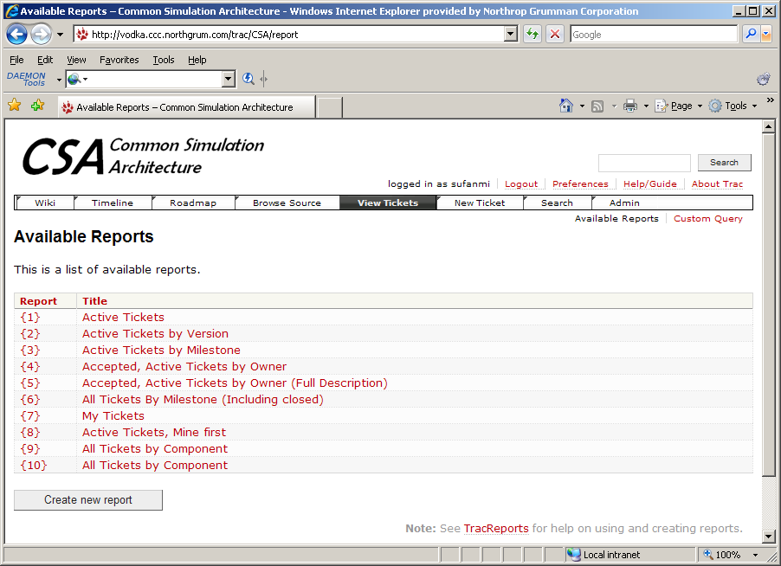
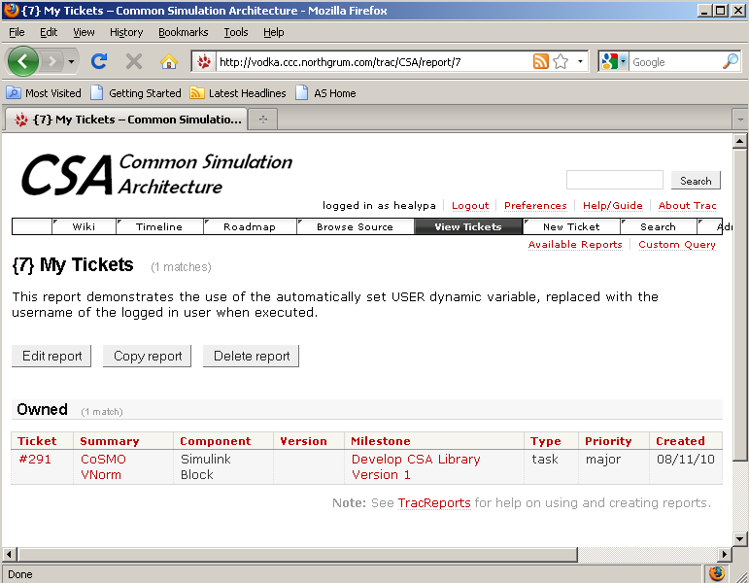
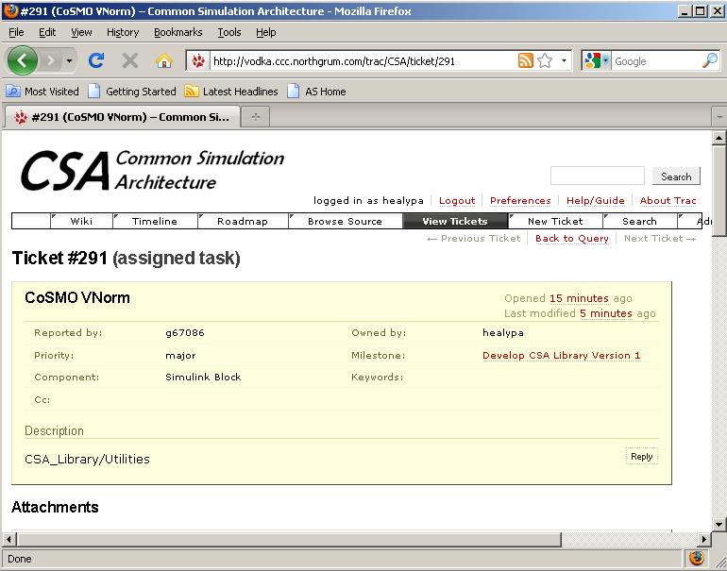
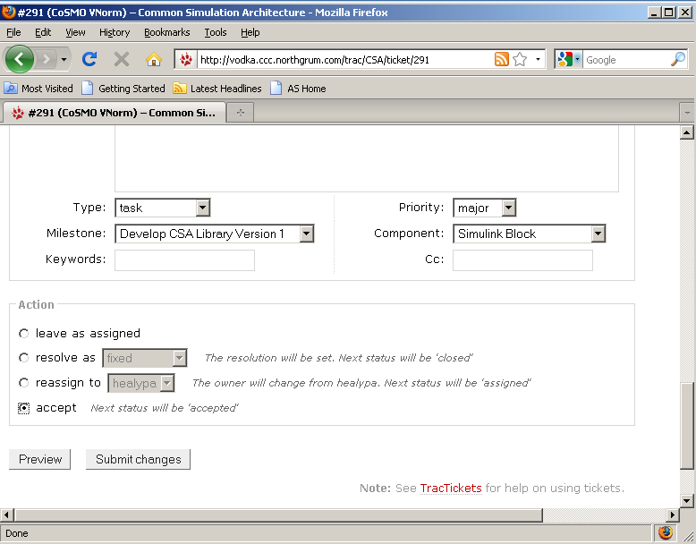
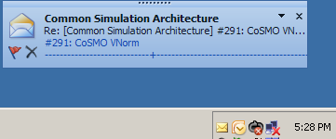
CoSMO Step-by-Step Process for Simulink Blocks
Step 3: Find Ticket Assigned to You
Click on ‘View Tickets’
Run the ‘My Tickets’ report to find tickets assigned to you
Step 4: Accept Ticket
Scroll down to the bottom of the ticket
Click on ‘accept’ and then ‘Submit changes’
You will receive an email confirmation that this ticket has been changed
Description will include the relative path to the Simulink Block in the CSA_Library.mdl that you’ll need to CoSMO

Slide 11
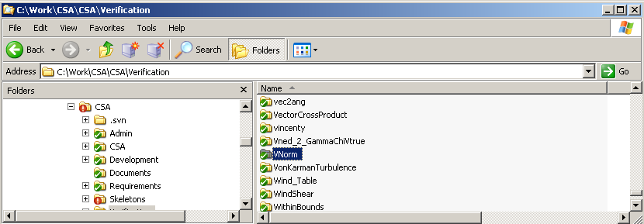
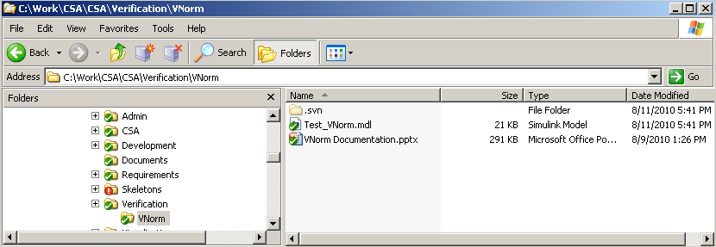
CoSMO Step-by-Step Process for Simulink Block
Step 5: Establish a Verification folder for your block
The Verification folder will have the same name as the Simulink block
If the folder does not exist, create it and add it to the CSA repository
Step 6: Establish Documentation for your block
Each component will have its own documentation file that will reside in each Verification subfolder
Check to see if ‘<Block> Documentation.pptx’ exists
If the documentation does not exist, copy the documentation template from here: http://vodka.ccc.northgrum.com/svn/CSA/trunk/Documents/Simulink%20Block%20Documentation%20Template.pptx and add it to the repository

Slide 12
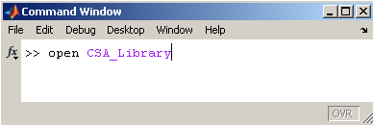
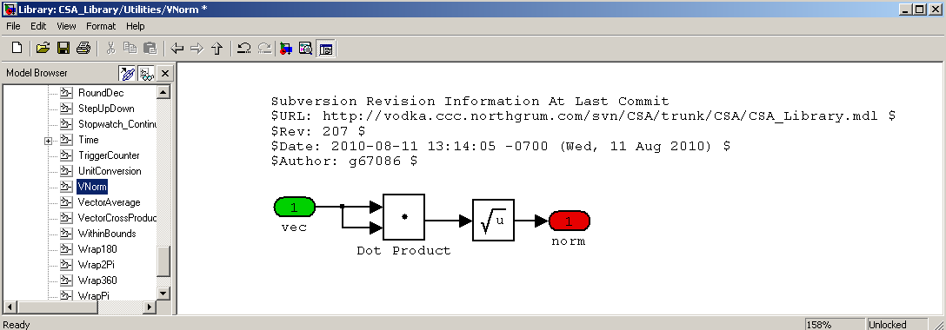
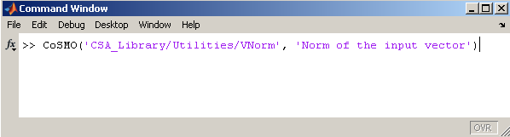
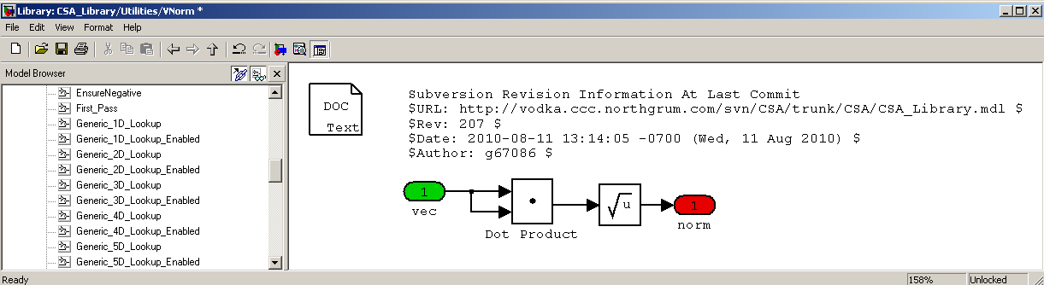
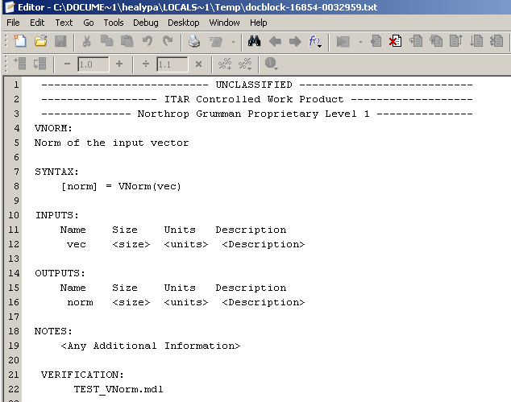
CoSMO Step-by-Step Process for Simulink Block
Step 7: Add the text Doc block to the Simulink Block
Open the CSA_Library.mdl
If your block is not yet a part of the CSA_Library, be sure to run slupdate on it first to ensure the block is updated to the same version of Simulink as the CSA_Library
If your block is already a part of the CSA_Library, locate the path to your block (should be in the Ticket assigned to you)
Use CoSMO.m to create a Doc text block for the Simulink block
Input 1 is the path to the Simulink block as a string
'CSA_Library/Utilities/VNorm'
Input 2 is a string of text of the description of the block
'Norm of the input vector'
Update the internal documentation fields as required
Don’t forget to update the revision history at the bottom of the function!
a.
b. Original Block
c. Function with added Doc
d. Fill in empty fields

Slide 13
CoSMO Step-by-Step Process for Simulink Block
Step 8: Create a Simulink Unit Test model that tests your block
Filename format will be ‘Test_<Block>.mdl’. Be sure to add this to the repository.
The test model must prove that the block operates as intended and should also account for what happens if the block is run inappropriately
The block’s complexity will dictate the amount of testing required within the test model
Add a call to ViewValues.m to the block callbacks to display values of constants in the block
ModelProperties > Callbacks > InitFcn > if(exist('ViewValues')) ViewValues(1); end
Run slupdate on the block to ensure that it is up to date with the CSA_Library’s version of Simulink. This is most easily done in the test model, because slupdate now requires the block to be able to be compiled. The library link will need to be disabled.
Step 9: Create a MATLAB driver script that test drives your block (if applicable)
A Driver script may be necessary if the block is complex enough to require offline calculations, extensive plotting, etc.
Filename format will be ‘DRIVER_<Block>.m’. Be sure to add this to the repository.
Make sure the DRIVER script is linked in ‘Test_<Block>.mdl’
For example, from the Command Window enter: AddTextBlock(bdroot, 'Click here to open ''DRIVER_VNorm.m''', 'ClickFcn', 'edit(''DRIVER_VNorm'');', 'Location', [10 400], 'FontWeight', 'bold', 'FontSize', 14)
Step 10: Test, Test and Test Some More
Iterate between the unit test, driver file and the block to ensure that the block is as strong and robust as possible
Major Questions that should be addressed
How could a user break this block (intentionally or unintentionally)?
Is there input/output error checking? Is there divide by zero protection?
Can the block be called with empty variables or strings (e.g. [ ] or ‘ ‘)?
Is it code generatable?
If this block has a reciprocal (e.g. eul2dcm and dcm2eul) then the test model should include both
Test cases should be a mix of easy and non-intuitive inputs
Angle blocks should be tested at 0 and perceivable singularities (e.g. ±90°, ±180°, ±360°)
Comparisons with hand calculations nice for complex equations
Out-of-range inputs should be tested to ensure block does not blow up

Slide 14
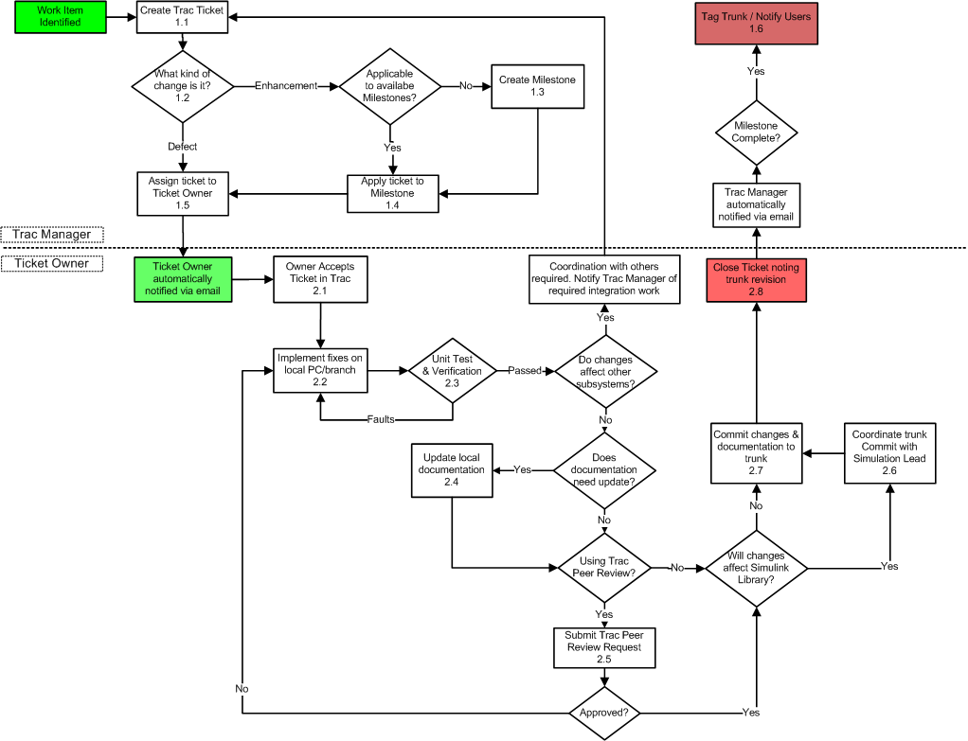
CSA Candidate SCM Process

Slide 15
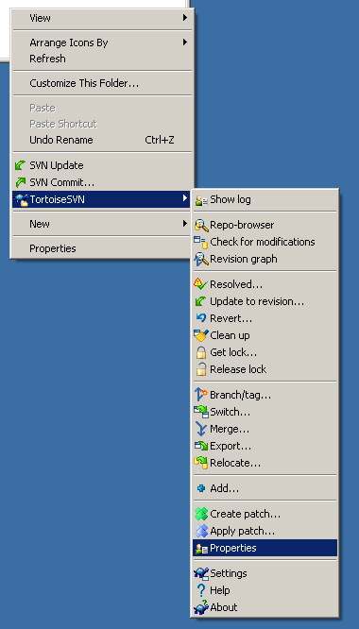
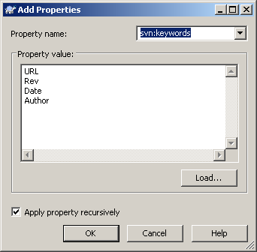
Working with Subversion: Dynamic Log Fields
Using ‘svn:keywords’ gives users greater insight into the origins and history of an SVN file (be it a MATLAB function, Simulink block, etc.)
Two Required Steps
Within the desired file, add the following four Tortoise keyword tags
$URL: $, $Rev: $, $Date: $, $Author: $
Using Windows Explorer, activate the keywords using TortoiseSVN→ Properties
What happens: Whenever a file with the aforementioned keywords is committed, Tortoise will fill in the URL, Rev, Date, and Author blanks
Let’s look at two examples…

Slide 16
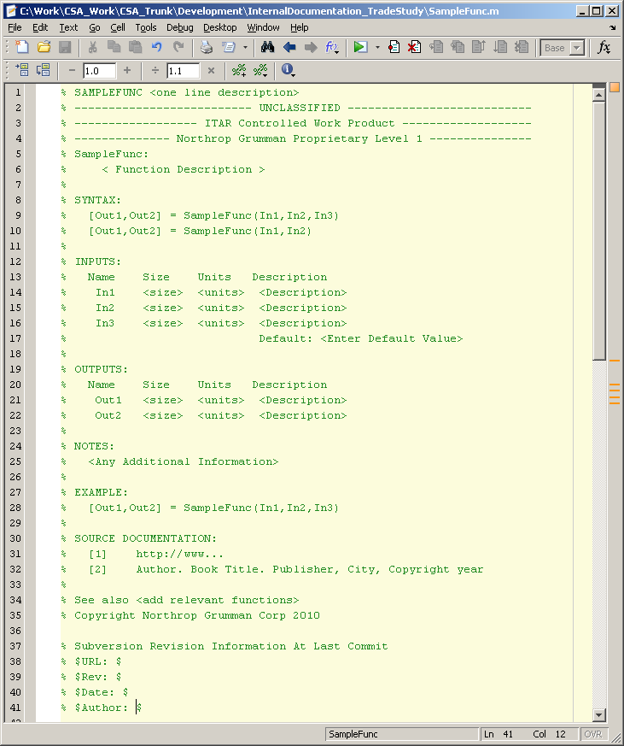
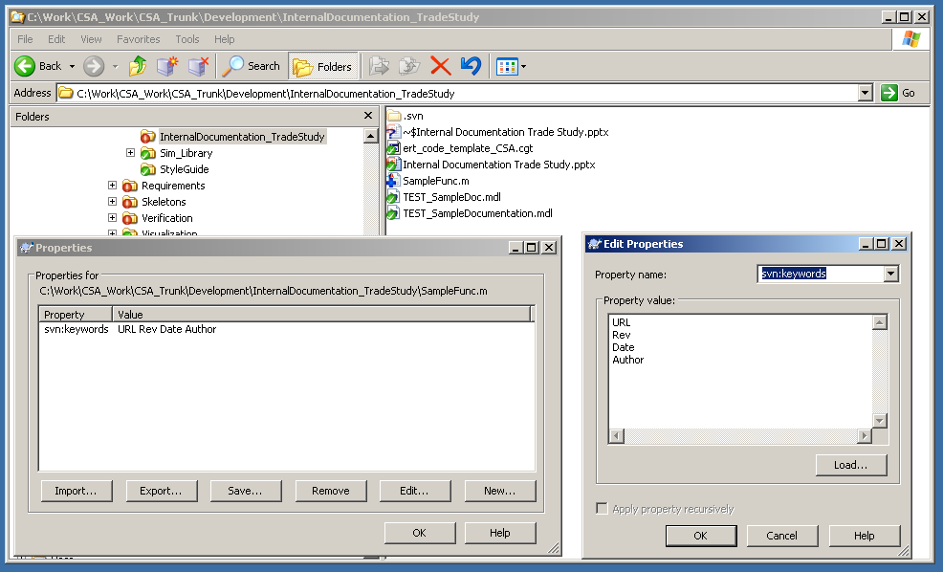
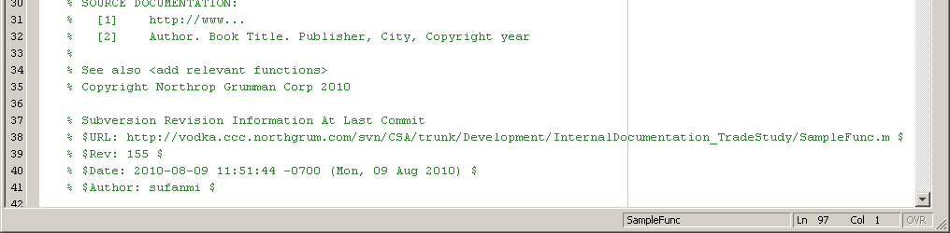
Working with Subversion: Dynamic Log Fields in MATLAB files
2: Right-click file and select Tortoise→SVN Add to mark file for SVN addition
3: Right-click file and select Tortoise→SVN Properties.
Add svn:keywords ‘URL’, ‘Rev’, ‘Date’, ‘Author’ to activate dynamic fields
4: Commit file
1: Create file with Blank fields
5: Note fields have been automatically populated by TortoiseSVN

Slide 17
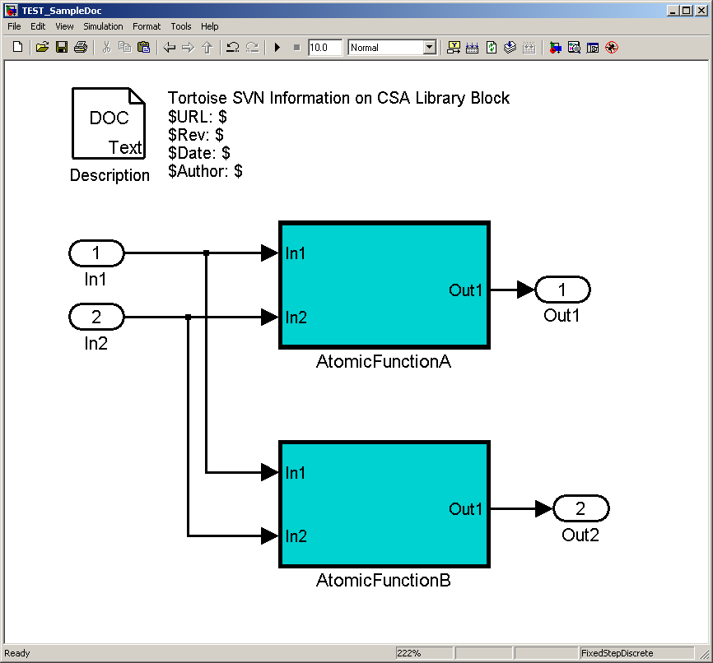
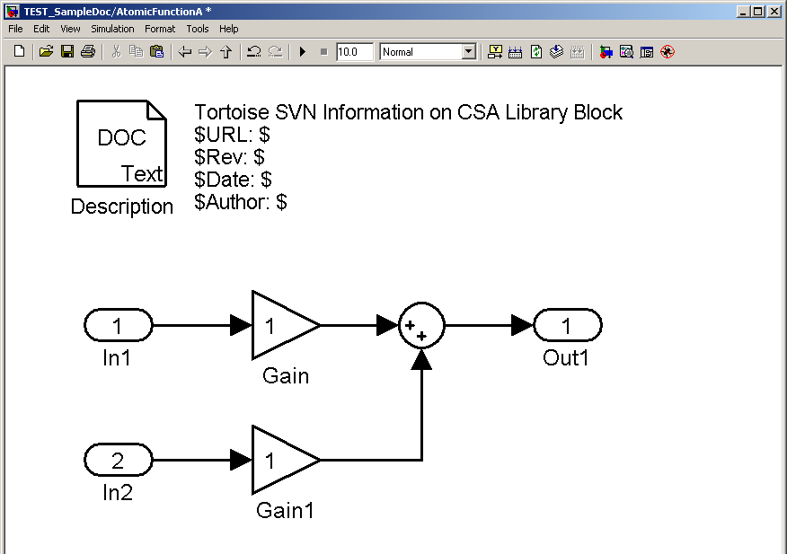
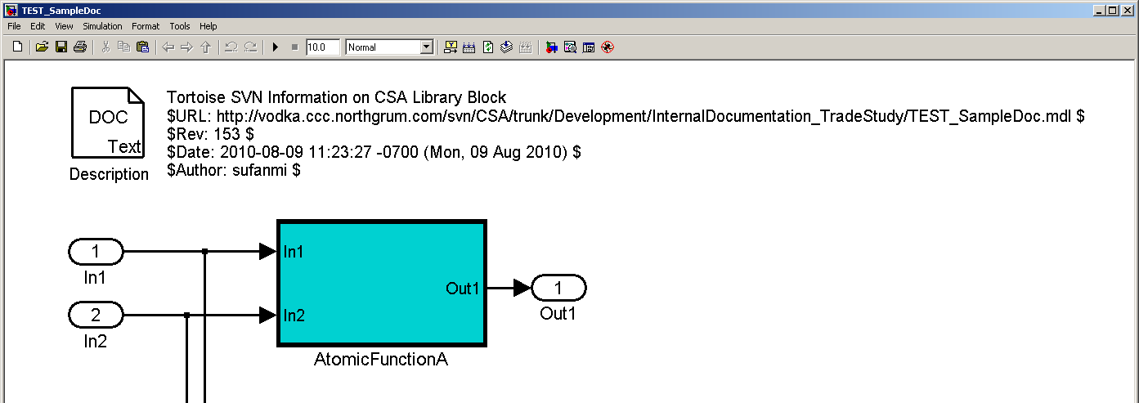
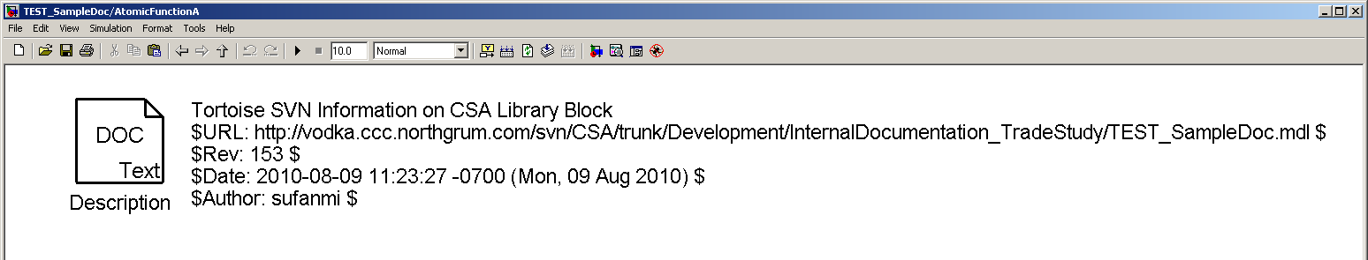
Working with Subversion: Dynamic Log Fields in Simulink Blocks
2: Right-click file and select Tortoise→SVN Add to mark file for SVN addition
3: Right-click file and select Tortoise→SVN Properties.
Add svn:keywords ‘URL’, ‘Rev’, ‘Date’, ‘Author’ to activate dynamic fields
4: Commit file
1: Create file with Blank fields
5: Note fields have been automatically populated by TortoiseSVN

Slide 18
Important Documents
Documentation Template
Components Documentation.pptx
CSA Component Verification Repository
http://vodka.ccc.northgrum.com/svn/CSA/trunk/Verification
CoSMO Intro Files
https://vodka.ccc.northgrum.com/svn/Documents/trunk/MBD/CoSMO

